Slide 1
Internet Slang —Evolution or Degradation?
宋亦寒 Alex
2025.12.26

Slide 2
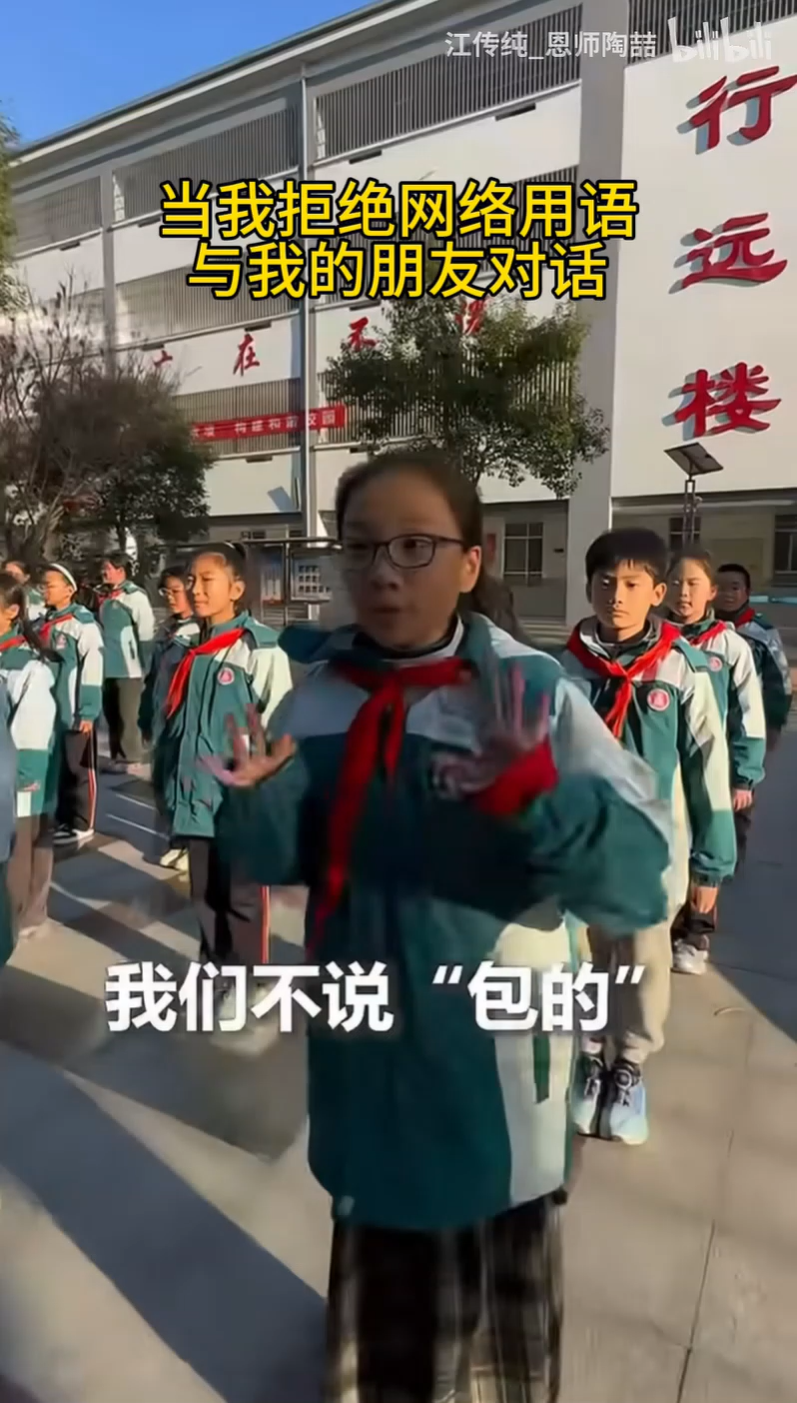
Here is a video that contrasts modern slang with classical precision, encouraging people to use classical expressions instead of slang.
——It’s a wrap.大功告成。圆满完成。
——It’s an inevitable destiny.不可避免的命运。
——These are my mom's hand-wrapped dumplings.
——These are “inevitable” dumplings made by my mom.

Slide 3
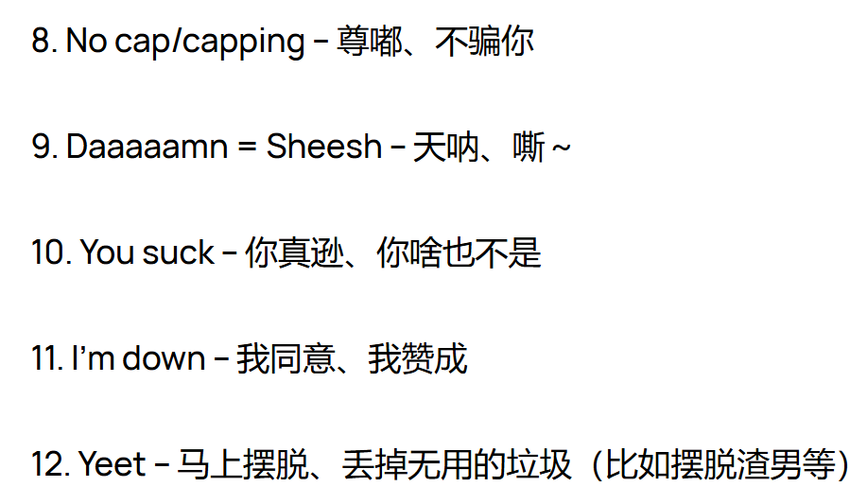
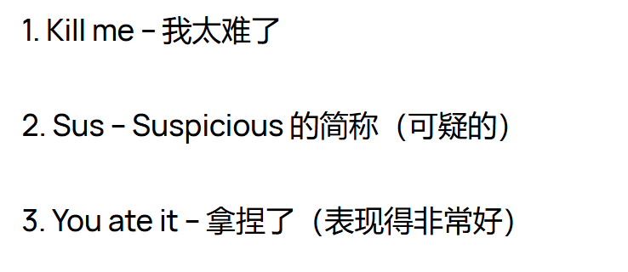
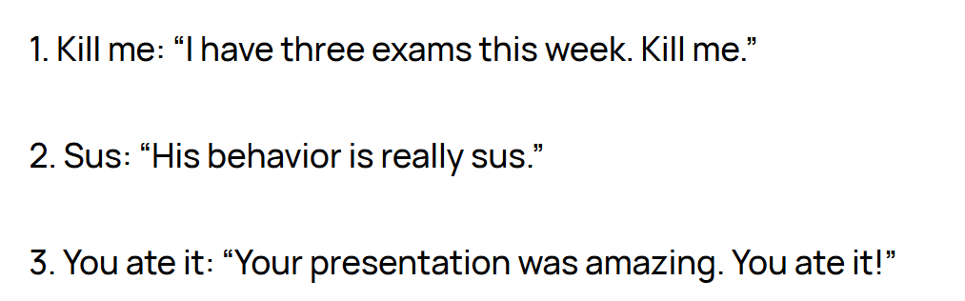
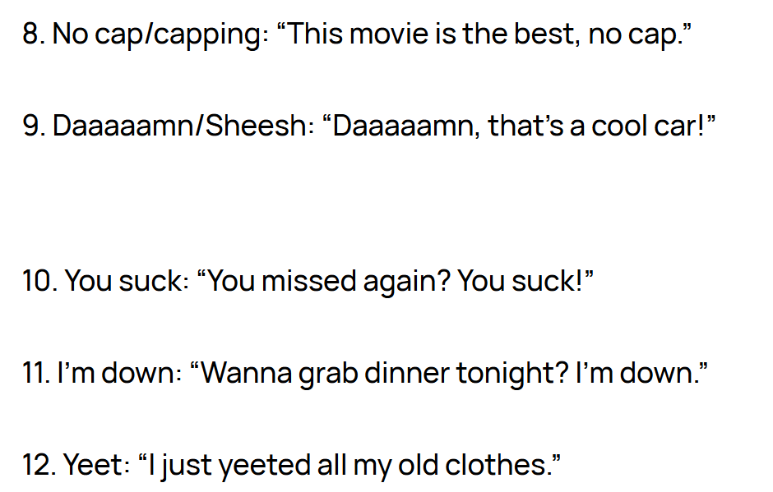
Introduction
We live in an era where internet slang and viral memes move faster than the speed of thought.

Slide 4
Argument A: Why We Love Slang
Efficient and expressive
Help us belong to a group
Interesting, fun and creative

Slide 5
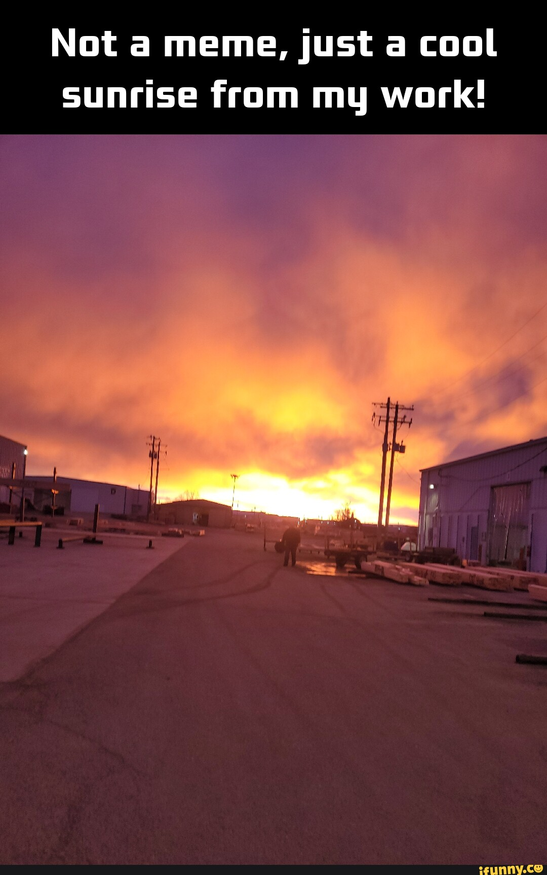
Argument B: The "Poverty of Language"
When we default to "It’s giving..." for every positive experience or "I'm dead" for every joke, we stop looking for the precise adjectives that truly define our feelings. If every beautiful sunset is just "aesthetic" and every minor inconvenience is "tragic”, our emotional vocabulary becomes smaller.
Deep thinking requires deep language.

Slide 6
Argument C: Critical Thinking
We should treat internet slang like seasoning in a dish. A little bit adds flavor and excitement, but too much ruins the meal.
We should not let the slang think for us. Instead of letting a viral trend dictate our reactions, we should use Internet slang as a creative supplement to a foundation of strong, diverse language skills.

Slide 7
Master the Tool, Don't Be the Tool
In conclusion, Internet slang is a reflection of our time: fast, funny, and connected.
Let us use the humor of the Internet to bridge gaps and build connections, but let us also cherish the beauty of the traditional dictionary. Let us ensure that while our fingers are busy typing the latest viral words, our minds remain capable of crafting original, profound, and timeless thoughts.

Slide 8
The internet can give us the slang, but only we can give the words meaning.

Slide 9
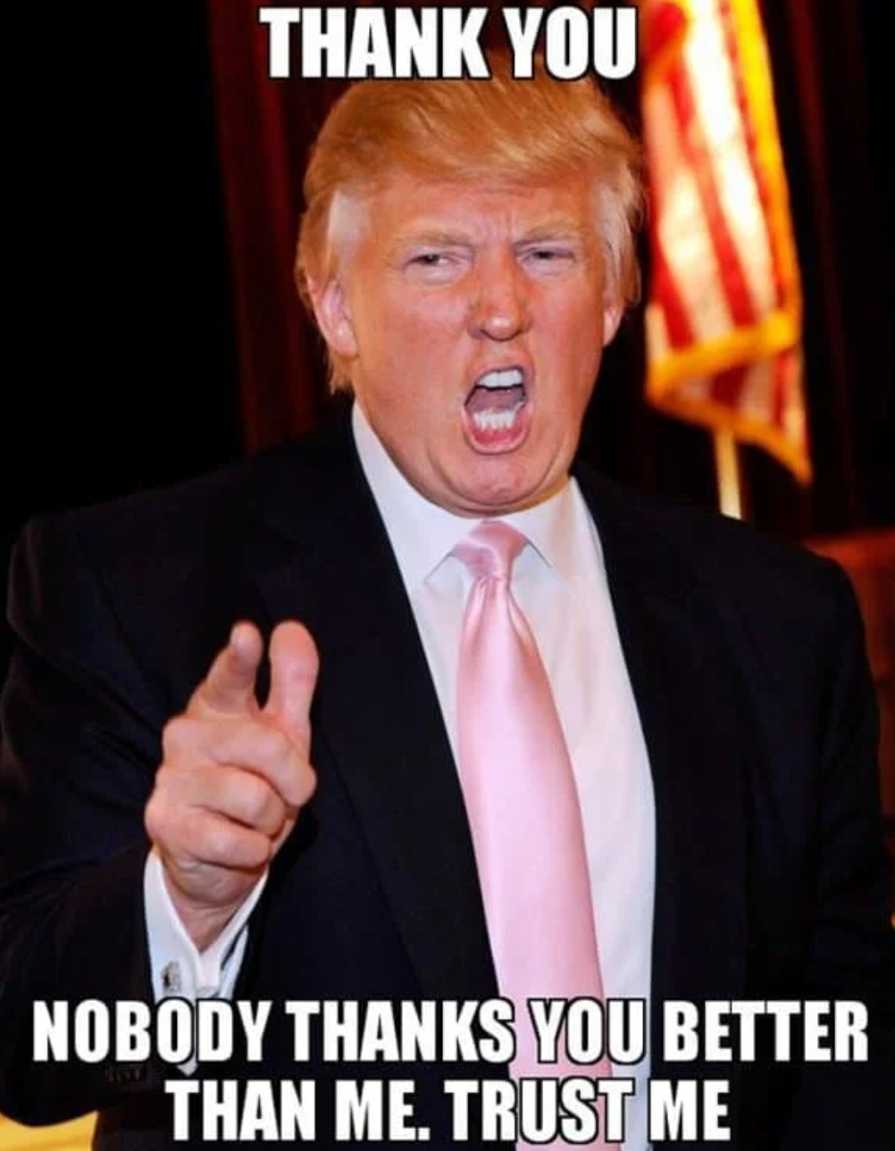
Thanks for listening
宋亦寒 Alex
2025.12.26

